Slide 1





Ecotag is an awesome labelling tool
Lilian Delouvy
Guillaume Chervet
ML Engineer
@LDelouvy
TechLead – ML Engineer @guiChervet

Slide 2
Why we built Ecotag and why it is an awesome tool !
Demo

Slide 3
Deep Learning
Artificial Intelligence
Machine Learning
Deep Learning

Slide 4
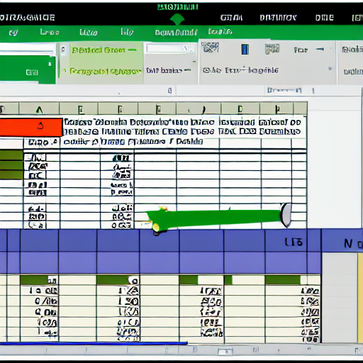
Deep Learning
Structured data
"excel structured data"

Slide 5


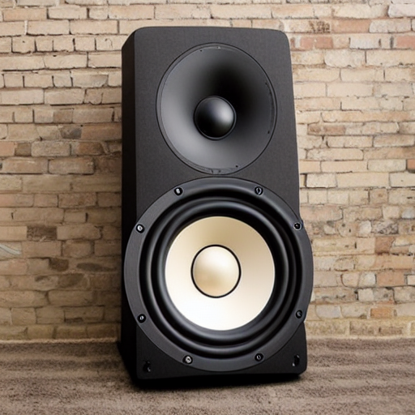
Deep Learning
Unstructured data
"text from an old book on a table"
"camera outside on the beach"
"big music speaker"

Slide 6


Deep Learning
Classical programming
Rules
Answers
Data
Machine Learning
Data
Rules
Answers
Source : François Chollet

Slide 7
Deep Learning
Code
Input
Output
AI model
Input
Output

Slide 8

Data is gold
Deep Learning
(Data centric)

Slide 9

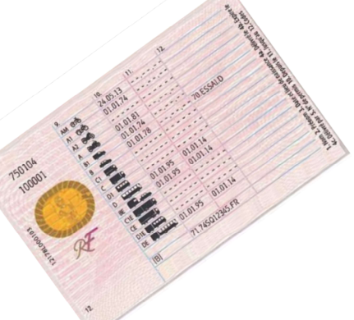



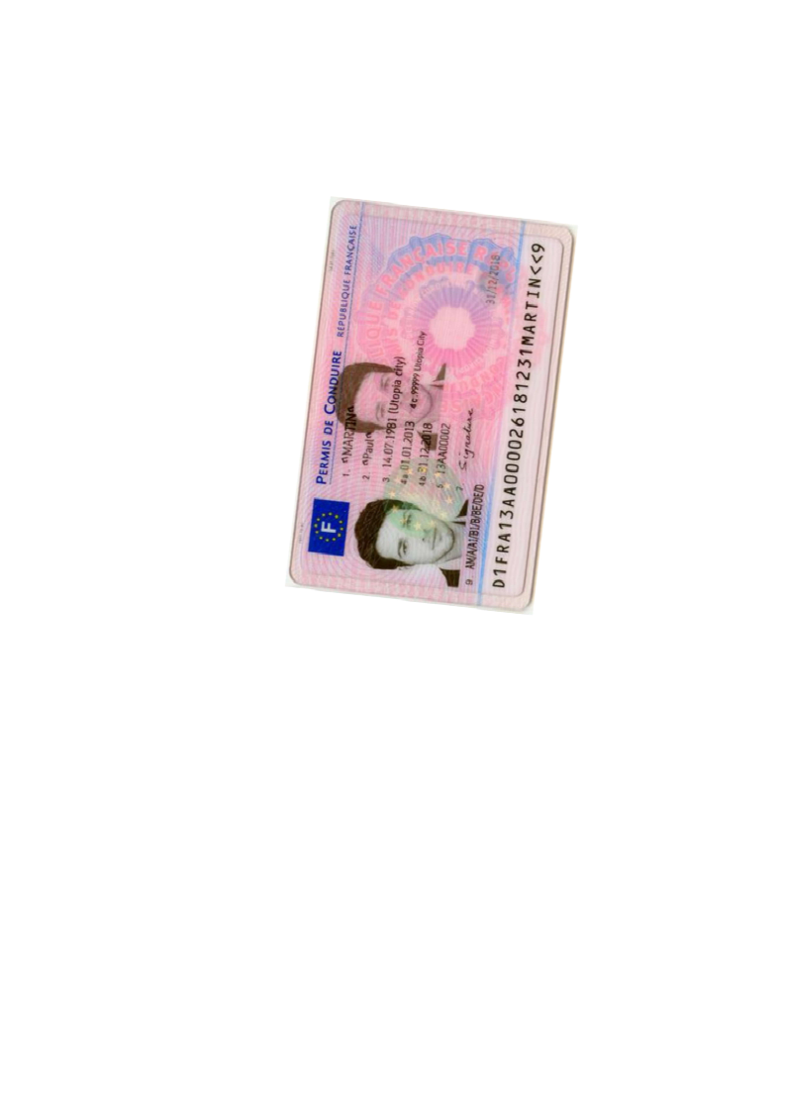
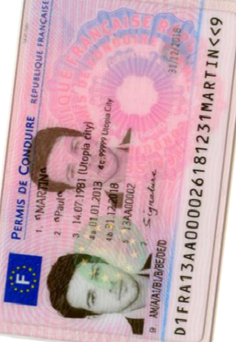
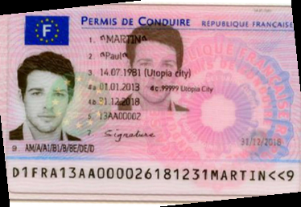
Production
Page
Zoning
Homography
Zoning
Zoning
OCR
OCR
Split
Split
Zoning
Homography
Zoning
OCR
Legend :
ML + code
Only code
Notes:
Guillaume
10 mins

Slide 10
Deep Learning
collect
Datasets

Slide 11
Deep Learning
collect
Datasets
use
Train AI

Slide 12
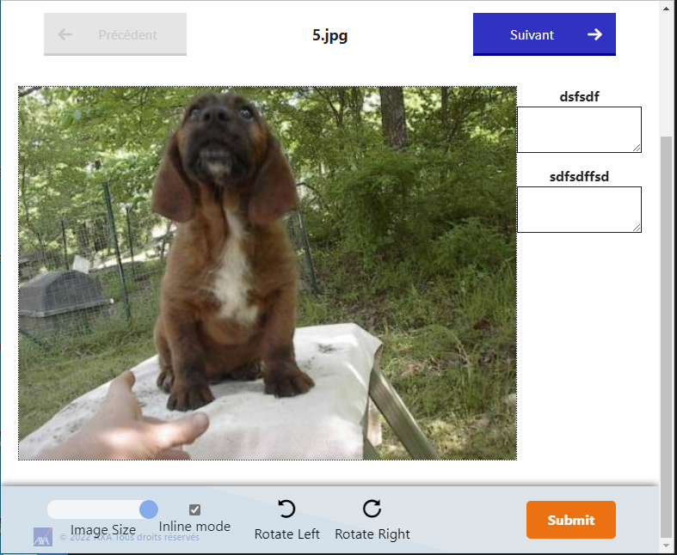
Ecotag
Deep Learning
collect
Datasets
use
Train AI

Slide 13
Ecotag
Deep Learning
collect
Datasets
use
Train AI
deploy
Production AI API

Slide 14
Ecotag
Deep Learning
collect
Datasets
use
Train AI
deploy
Production AI API
use
Consumer Production application

Slide 15
Ecotag
Deep Learning
collect
Datasets
use
Train AI
deploy
Production AI API
use
Consumer Production application
collect
Feedback Loop

Slide 16
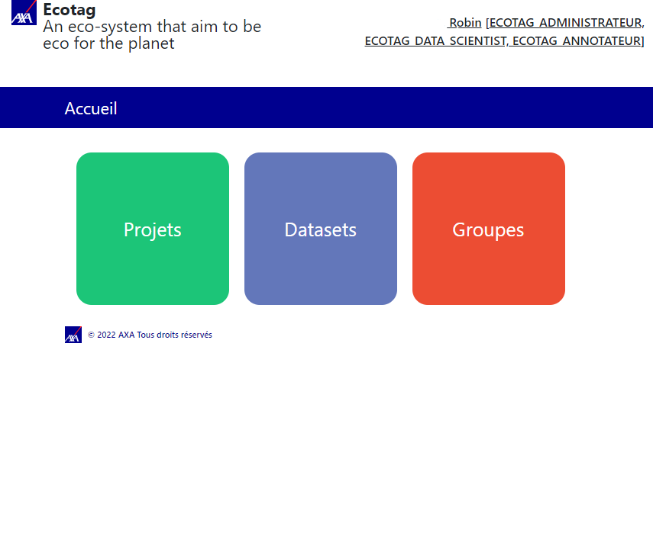
Open Source
https://github.com/AxaGuilDEv/ml-cli

Slide 17
Demo
Deep Learning

Slide 18

Conclusion
"three people hugging"

Slide 19
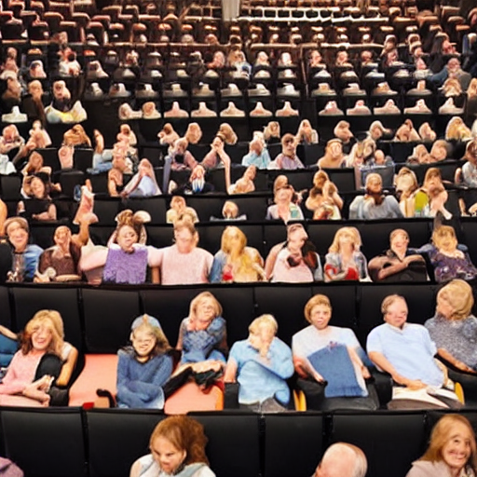
Thank you☺
"thank and hug the public in a theater"

Slide 20
Dataset of 20 000 files
Deep Learning
Train a model
13 000 train
4 000 test
3 000 validation

Slide 21

Data drift
Deep Learning
"a race car drift deep on a road in a bend"

Slide 22

Deep Learning
"the god graal trophy"
Notes:
C’est quoi le graal ?

Slide 23
Deep Learning
Configuration
Data Collection
Data Verification
Machine Resource Management
Serving Infrastructure
Monitoring
ML Code
Analysis Tools
Feature Extraction
Process Management Tools
Source : Google, The Hidden Technical Debt In Machine Learning Systems

